Slide 1



REST Services
HTTP, RESTful Web Services, HTTP and REST Tools: Postman, Fiddler
SoftUni Team
Technical Trainers
Software University
http://softuni.bg

Slide 2
Table of Contents
The HTTP Protocol
HTTP Developer Tools
REST and RESTful Services
Accessing the GitHub API
Using Firebase BaaS
Using Kinvey mBaaS

Slide 3
Have a Question?
sli.do #JS-CORE

Slide 4



HTTP Basics
HTTP (Hyper Text Transfer Protocol)
Text-based client-server protocol for the Internet
For transferring Web resources (HTML files, images, styles, etc.)
Request-response based
HTTP request
HTTP response
Web Client
Web Server

Slide 5






HTTP Request Methods
HTTP defines methods to indicate the desired action to be performed on the identified resource
Method | Description
GET | Retrieve / load a resource
POST | Create / store a resource
PUT | Update a resource
DELETE | Delete (remove) a resource
PATCH | Update resource partially
HEAD | Retrieve the resource's headers
OPTIONS | Returns the HTTP methods that the server supports for the specified URL

Slide 6
HTTP GET Request - Example
GET /users/testnakov/repos HTTP/1.1
Host: api.github.com
Accept: */*
Accept-Language: en
Accept-Encoding: gzip, deflate
User-Agent: Mozilla/5.0 (Windows NT 10.0; WOW64) AppleWebKit/537.36 (KHTML, like Gecko) Chrome/54.0.2840.71 Safari/537.36
Connection: Keep-Alive
Cache-Control: no-cache
<CRLF>
HTTP request line
HTTP headers
The request body is empty

Slide 7
HTTP POST Request - Example
POST /repos/testnakov/test-nakov-repo/issues HTTP/1.1
Host: api.github.com
Accept: */*
Accept-Language: en
Accept-Encoding: gzip, deflate
User-Agent: Mozilla/4.0 (compatible;MSIE 6.0; Windows NT 5.0)
Connection: Keep-Alive
Cache-Control: no-cache
<CRLF>
{"title":"Found a bug",
"body":"I'm having a problem with this.",
"labels":["bug","minor"]}
<CRLF>
HTTP request line
HTTP headers
The request body holds the submitted data

Slide 8
HTTP Response - Example
HTTP/1.1 200 OK
Date: Fri, 11 Nov 2016 16:09:18 GMT+2
Server: Apache/2.2.14 (Linux)
Accept-Ranges: bytes
Content-Length: 84
Content-Type: text/html
<CRLF>
<html>
<head><title>Test</title></head>
<body>Test HTML page.</body>
</html>
HTTP response status line
HTTP response headers
HTTP response body

Slide 9
HTTP Response Status Codes
Status Code | Action | Description
200 | OK | Successfully retrieved resource
201 | Created | A new resource was created
204 | No Content | Request has nothing to return
301 / 302 | Moved | Moved to another location (redirect)
400 | Bad Request | Invalid request / syntax error
401 / 403 | Unauthorized | Authentication failed / Access denied
404 | Not Found | Invalid resource
409 | Conflict | Conflict was detected, e.g. duplicated email
500 / 503 | Server Error | Internal server error / Service unavailable

Slide 10
Content-Type and Disposition
The Content-Type / Content-Disposition headers specify how the HTTP request / response body should be processed
JSON-encoded data
Content-Type: application/json
UTF-8 encoded HTML page. Will be shown in the browser
Content-Type: text/html; charset=utf-8
Content-Type: application/pdf
Content-Disposition: attachment; filename="Financial-Report-April-2016.pdf"
This will download a PDF file named Financial-Report-April-2016.pdf

Slide 11

HTTP Developer Tools
Chrome Dev Tools, Fiddler, Postman

Slide 12
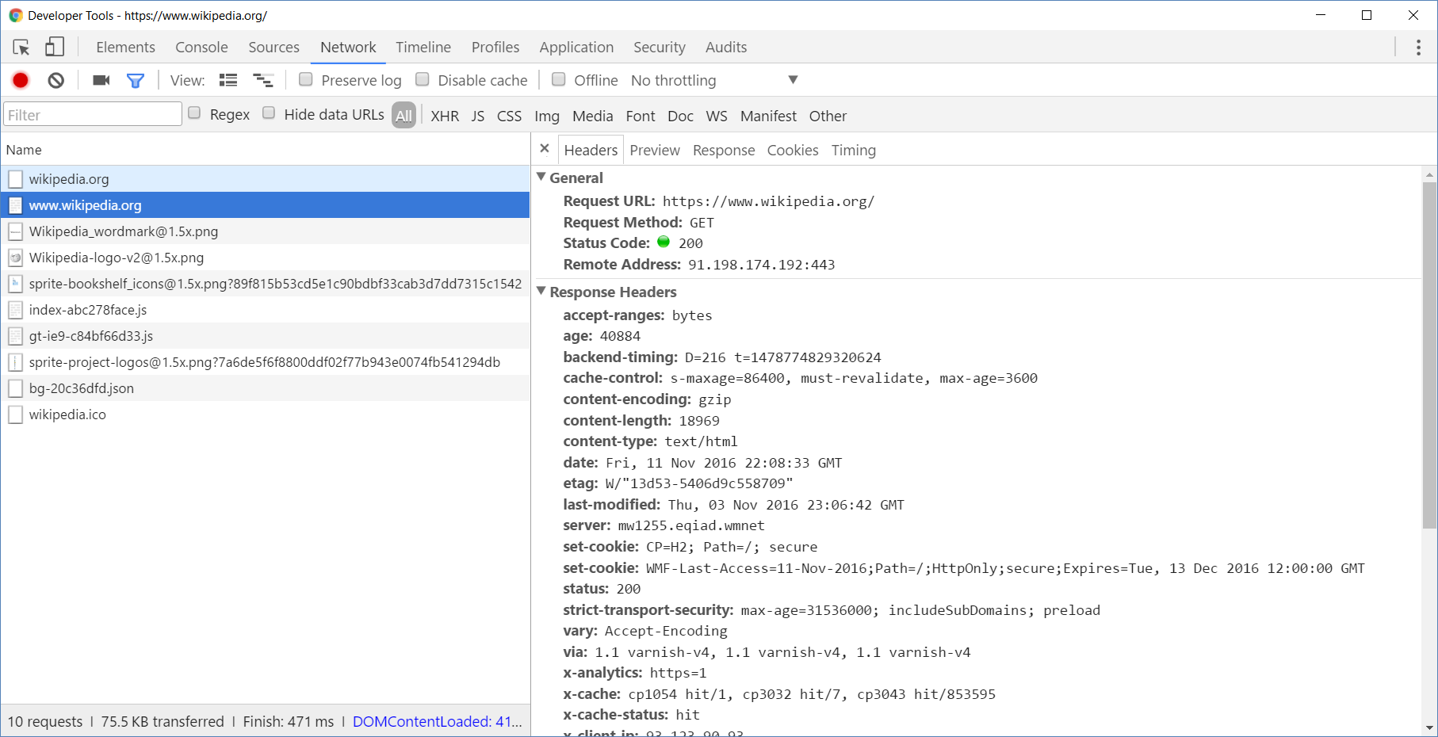
Chrome Developer Tools
Read more about Chrome Developer Tools

Slide 13
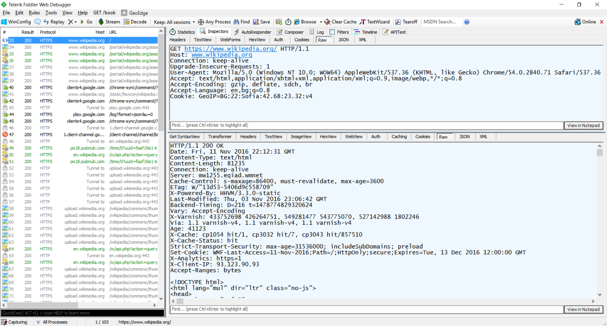
Fiddler
Read more about Fiddler

Slide 14
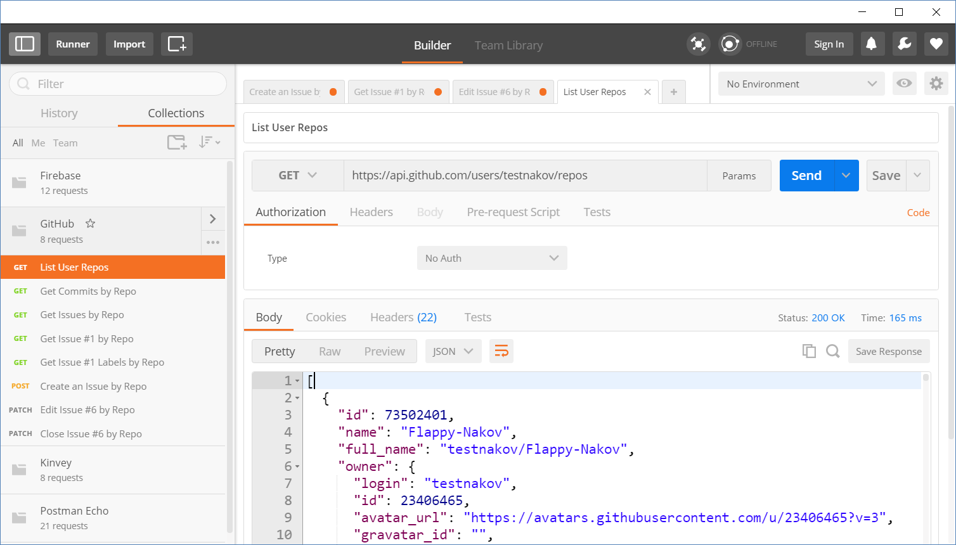
Postman
Read more about Postman REST Client

Slide 15
REST and RESTful Services
Representational State Transfer (REST)
Architecture for client-server communication over HTTP
Resources have URI (address)
Can be created/retrieved/ modified/deleted/etc.
RESTful API/RESTful Service
Provides access to server-side resources via HTTP and REST
REST Web Service
URI
Resource
Representation 1
Representation 2
Representation 3
Representation 4
GET
PUT
POST
DELETE
Uniform Method

Slide 16

REST Architectural Constraints
REST defines 6 architectural constraints which make any web service - a true RESTful API
Client-server architecture
Statelessness
Cacheable
Layered system
Code on demand (optional)
Uniform interface
Read more about REST Architectural Constraints

Slide 17
Authentication vs. Authorization
Authentication
The process of verifying the identity of a user or computer
Questions: Who are you? How you prove it?
Credentials can be password, smart card, external token, etc.
Authorization
The process of determining what a user is permitted to do on a computer or network
Questions: What are you allowed to do? Can you see this page?

Slide 18
REST and RESTful Services - Example
Create a new post
Get all posts / specific post
Delete existing post
Replace / modify existing post
POST
http://some-service.org/api/posts
GET
http://some-service.org/api/posts
GET
http://some-service.org/api/posts/17
DELETE
http://some-service.org/api/posts/17
PUT/PATCH
http://some-service.org/api/posts/17

Slide 19

GitHub REST API
Accessing GitHub through HTTP

Slide 20
GitHub API
List user's all public repositories:
Get all commits from a public repository:
Get all issues/issue #1 from a public repository
GET
https://api.github.com/users/testnakov/repos
GET
https://api.github.com/repos/testnakov/softuniada-2016/commits
GET
/repos/testnakov/test-nakov-repo/issues
GET
/repos/testnakov/test-nakov-repo/issues/1

Slide 21
GitHub API (2)
Get all labels for certain issue from a public repository:
Create a new issue to certain repository (with authentication)
GET
https://api.github.com/repos/testnakov/test-nakov-repo/issues/1/labels
POST
https://api.github.com/repos/testnakov/test-nakov-repo/issues
Headers
Authorization: Basic base64(user:pass)
Body
{"title":"Found a bug",
"body": "I'm having a problem with this."}

Slide 22

Firebase
Real-Time Cloud DB and App Platform by Google

Slide 23

Firebase
Mobile and web development platform. It provides:
Realtime database
Backend as a service
JSON-based data structure

Slide 24
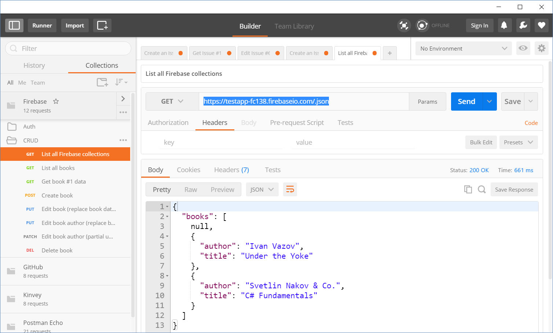
Accessing Firebase REST API with Postman
Append .json to your DB object URL

Slide 25

Firebase
Firebase Demo

Slide 26
Firebase REST API - CRUD Operations
GET
https://testapp-fc138.firebaseio.com/.json
GET
https://testapp-fc138.firebaseio.com/books.json
GET
https://testapp-fc138.firebaseio.com/books/1.json
GET
https://testapp-fc138.firebaseio.com/books/1/author.json
POST
https://testapp-fc138.firebaseio.com/books.json
Body
{"title":"New title", "author":"New author"}
DELETE
https://testapp-fc138.firebaseio.com/books/6.json

Slide 27
Firebase REST API - CRUD Operations (2)
PUT
https://testapp-fc138.firebaseio.com/books/7.json
Body
{"title":"Edited", "year":1980, "ISBN":"954X"}
PATCH
https://testapp-fc138.firebaseio.com/books/7.json
Body
{"year":1981, "author":"Author Changed"}
PUT
https://testapp-fc138.firebaseio.com/books/7/author.json
Body
"New author was assigned"
DELETE
https://testapp-fc138.firebaseio.com/books/7/author.json
Check your solution here: https://judge.softuni.bg/Contests/1567/Lab-HTTP-and-REST

Slide 28

Kinvey
Collection-Based Cloud DB (mBaaS)

Slide 29


Kinvey as Back-End
Mobile Back-End as a Service (mBaaS)
Holds your app / mobile app data in the cloud
Hold users and user data
Users (API for creating an account)
Data collections (API for CRUD operations)
Files (upload / download / delete)

Slide 30
Kinvey Demo

Slide 31
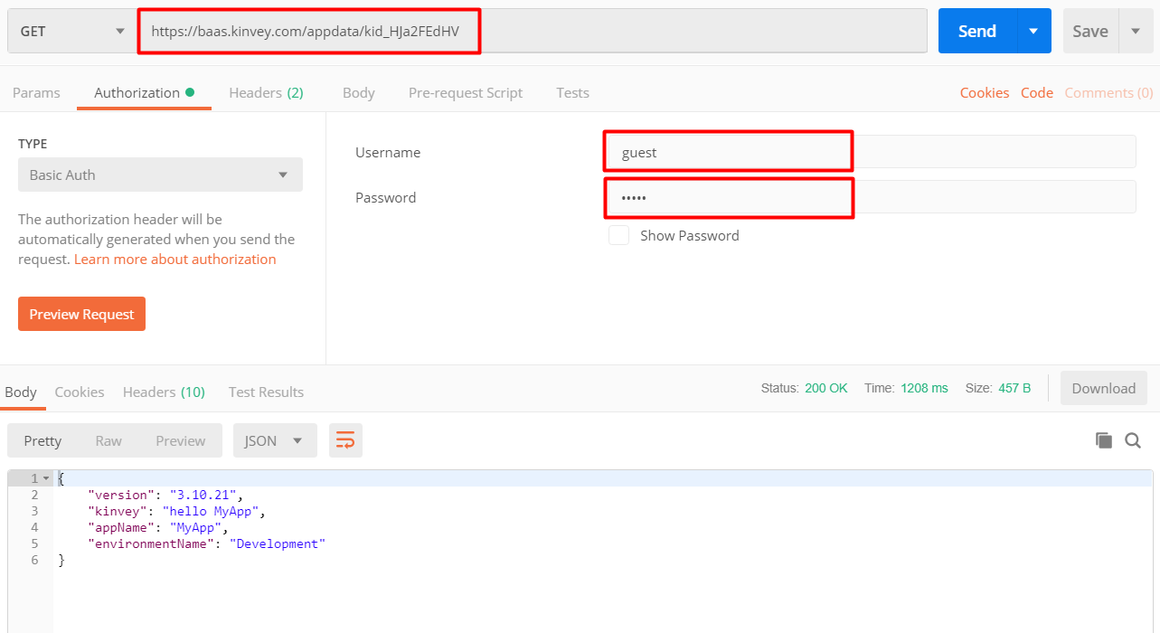
Test Your Backend with Postman
https://baas.kinvey.com/appdata/{app_id}
Basic authentication user: guest
pass: guest
Check your solution here: https://judge.softuni.bg/Contests/1567/Lab-HTTP-and-REST

Slide 32
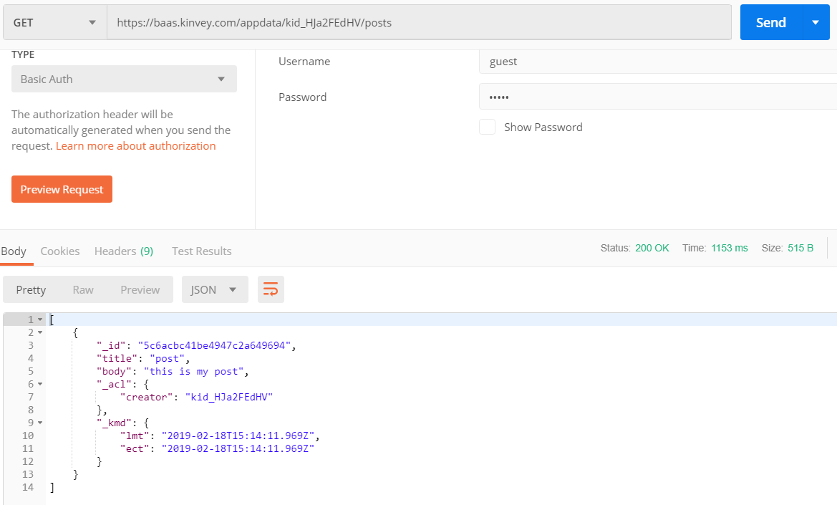
Kinvey and Postman: List All Posts
URL: https://baas.kinvey.com/appdata/{app_id}/posts
Method: GET
Authentication: Basic
User: guest
Pass: guest
Check your solution here: https://judge.softuni.bg/Contests/1567/Lab-HTTP-and-REST

Slide 33
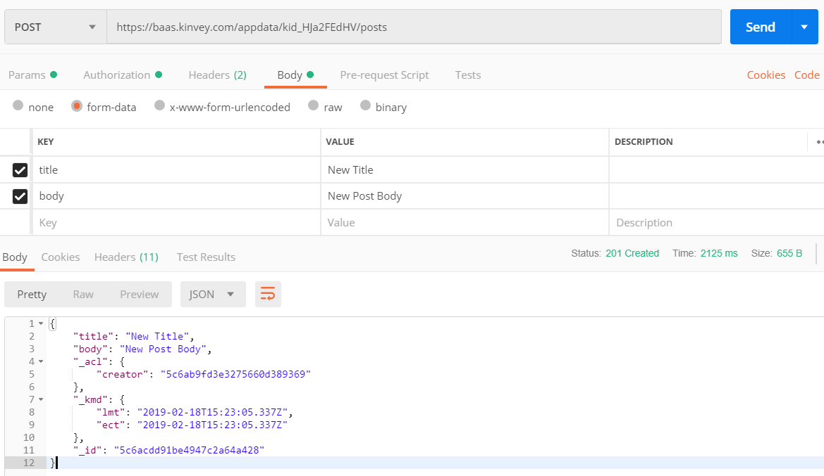
Kinvey and Postman: Create a New Post
URL: https://baas.kinvey.com/appdata/{app_id}/posts
Method: POST
Authentication: Basic
User / pass: guest / guest
Request body
title: New Title
body: New Post Body
Check your solution here: https://judge.softuni.bg/Contests/1567/Lab-HTTP-and-REST

Slide 34
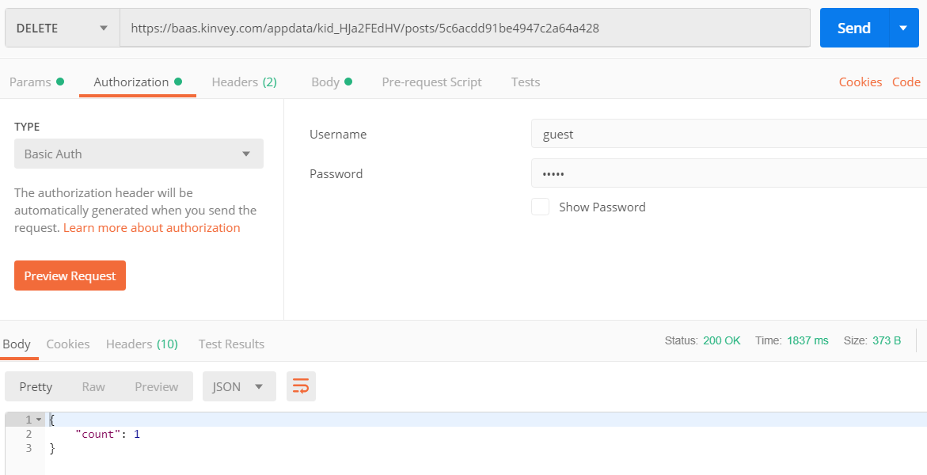
Kinvey and Postman: Delete an Existing Post
URL: https://baas.kinvey.com/appdata/{app_id}/posts/id
Choose an existing post's ID
Method: DELETE
Authentication: Basic
User / pass: guest / guest
Body: (empty)
Check your solution here: https://judge.softuni.bg/Contests/1567/Lab-HTTP-and-REST

Slide 35
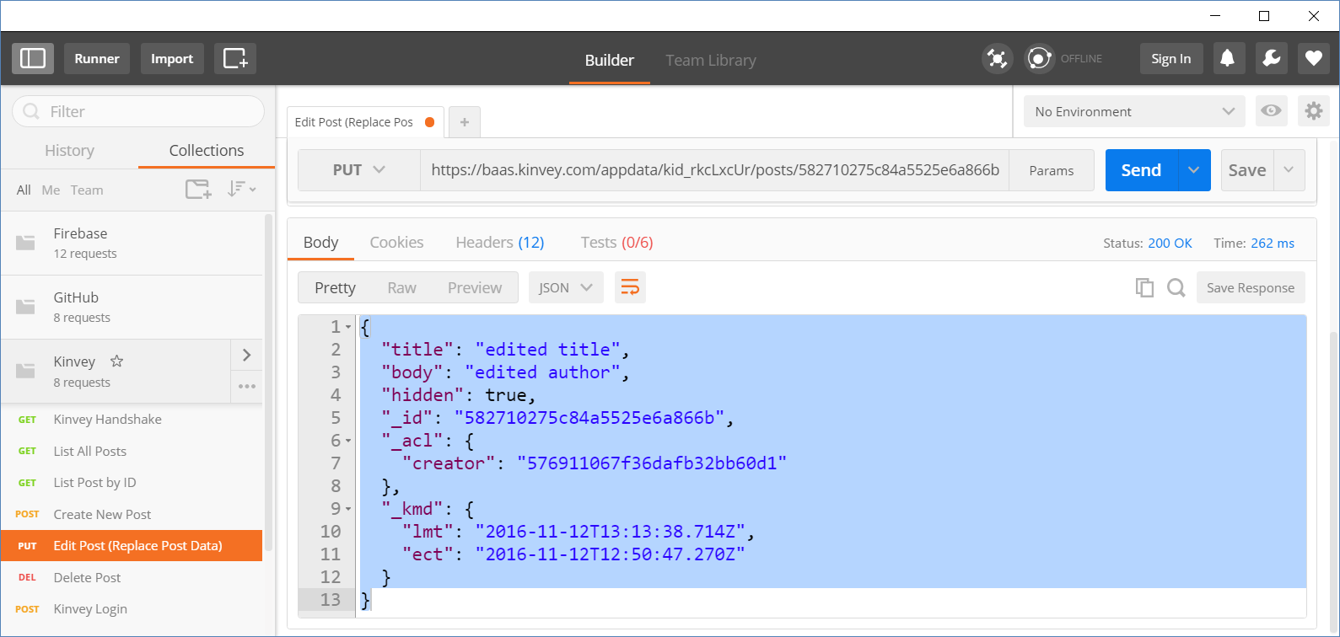
Kinvey and Postman: Edit an Existing Post
URL: https://baas.kinvey.com/appdata/{app_id}/posts/id
Choose an existing post's ID
Method: PUT
Authentication: Basic
User / pass: guest / guest
Body (JSON):
{"title":"edited title", "body":"edited author", "hidden":true}
Check your solution here: https://judge.softuni.bg/Contests/1567/Lab-HTTP-and-REST

Slide 36
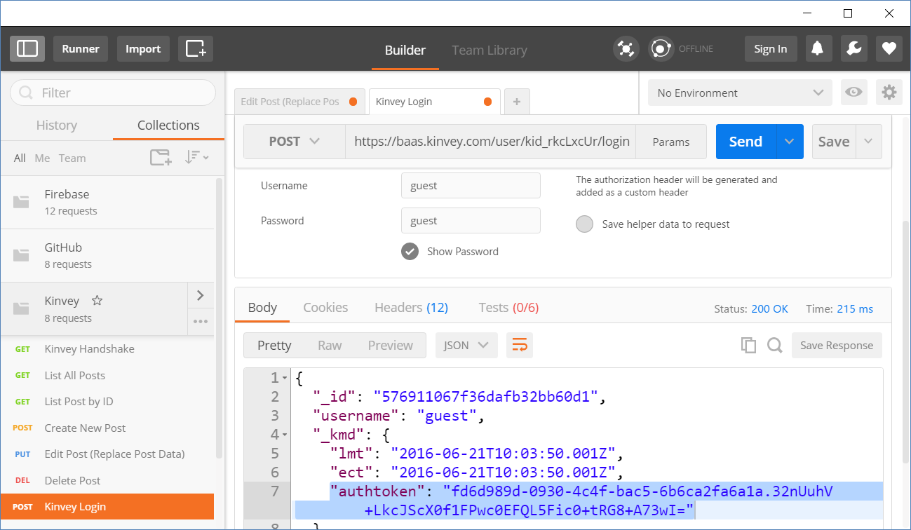
Kinvey and Postman: Login
URL: https://baas.kinvey.com/user/{app_id}/login
Method: POST
Authentication: Basic
User/pass: app_id : app_secret
Body:
Returns: authtoken
{"username":"…", "password":"…"}
"authtoken": "fd6d989d-0930-4c…wI="
Check your solution here: https://judge.softuni.bg/Contests/1567/Lab-HTTP-and-REST

Slide 37
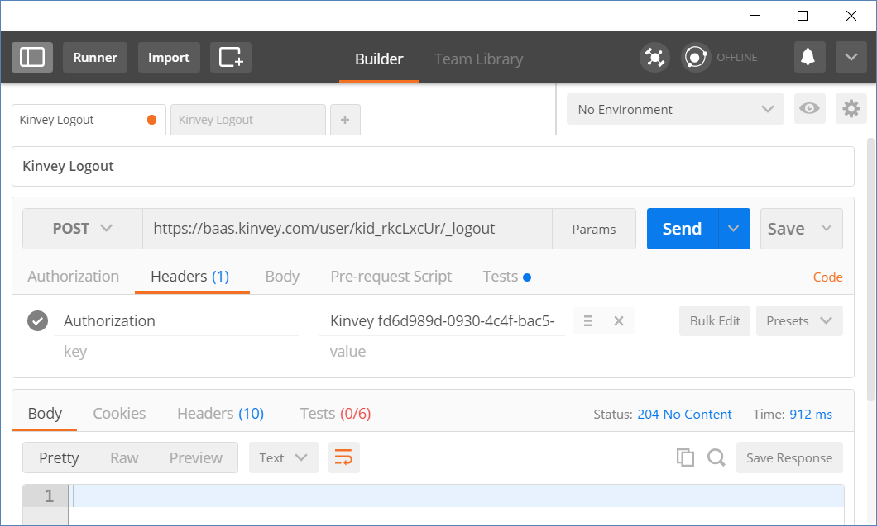
Kinvey and Postman: Logout
URL: https://baas.kinvey.com/user/{app_id}/_logout
Method: POST
Authorization:
Kinvey <authtoken>
Use the token given by the login request
Returns 204 No Content
Authorization:
Kinvey <authtoken>

Slide 38

Summary
…
…
…
HTTP is text-based request-response protocol
REST uses GET, POST, PUT, PATCH, DELETE
RESTful services address resources by URL
Provide CRUD operations over HTTP
Firebase is JSON-based cloud database
(mBaaS) with REST API
Kinvey is collection-based could database (mBaaS)

Slide 39
https://softuni.bg/courses/js-apps

Slide 40













SoftUni Diamond Partners

Slide 41




SoftUni Organizational Partners

Slide 42




Trainings @ Software University (SoftUni)
Software University - High-Quality Education and Employment Opportunities
softuni.bg
Software University Foundation
http://softuni.foundation/
Software University @ Facebook
facebook.com/SoftwareUniversity
Software University Forums
forum.softuni.bg

Slide 43

License
This course (slides, examples, demos, videos, homework, etc.) is licensed under the "Creative Commons Attribution-NonCommercial-ShareAlike 4.0 International" license

